Slide 1
Please feel free to ask any questions via Q and A
in the center

Slide 2
Election Day 2020
Tuesday, November 3rd
Elections are mentioned 33 times in the Constitution
Mail in Ballots
$400M for states to “increase the ability to vote by mail, expand early voting and online registration, and increase the safety of voting in-person by providing additional voting facilities and more poll-workers.”

Slide 3
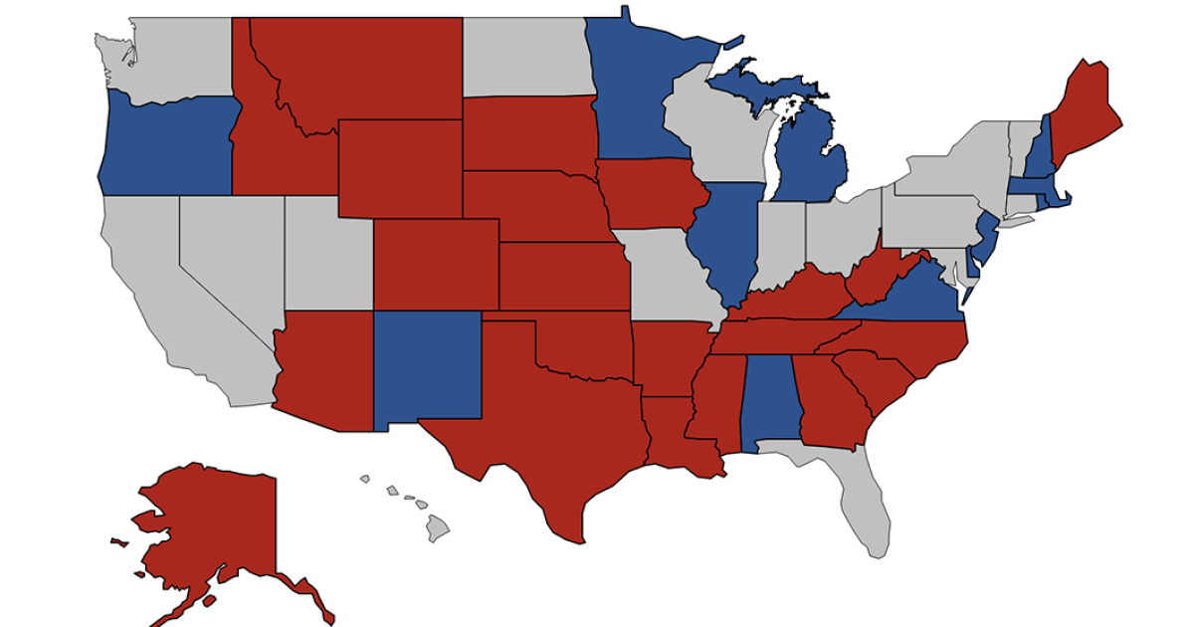
2020 Senate Races

Slide 4
Senate Membership
45 = Democrats
53 = Republicans
2 = Independents

Slide 5
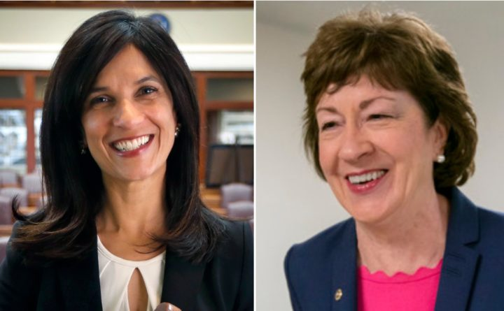
Maine
State House Speaker Sara Gideon vs. Senator Susan Collins (R)
Served since 1997
2014 – 68% win
47% to 43% - most recent poll
Justice Brett Kavanaugh
Republican Senator facing reelection in a state President Trump lost 4 years ago

Slide 6
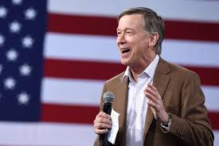
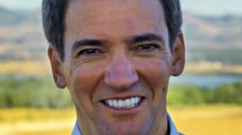
Colorado
Fmr. Gov. John Hickenlooper
Fmr. State House Speaker Andrew Romanoff
Second Republican Senator facing reelection in a state President Trump lost 4 years ago
Won in 2014 with 48% of the vote

Slide 7
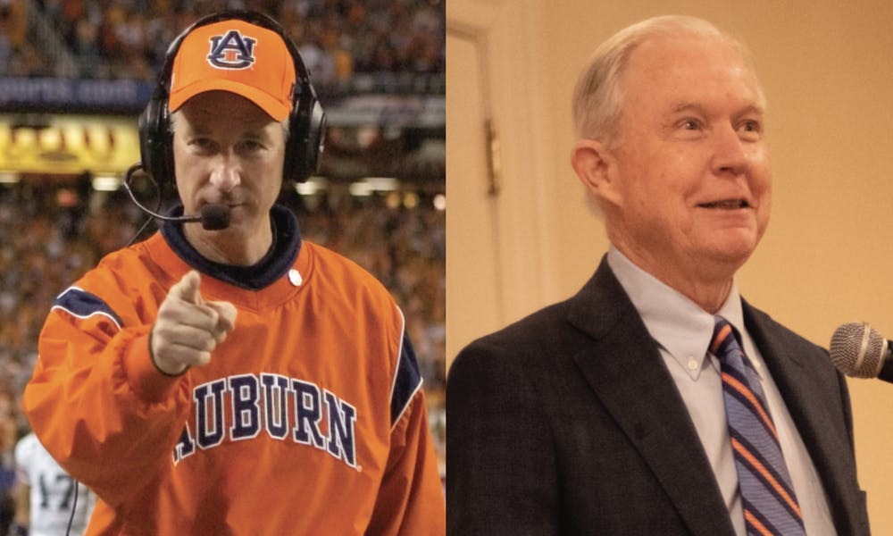
Alabama
Senator Doug Jones was the first Democrat to win statewide since 2008
Special Election in 2017
Auburn Football Coach Tommy Tuberville Endorsed by President Trump vs. Former Senator and Attorney General Jess Sessions

Slide 9
Pre-2018 Elections

Slide 10
House Membership
232 = Democrats
196 = Republicans
1 = Independents

Slide 11
2020 House Landscape

Slide 12
Congresswoman Elissa Slotkin – Armed Services Committee
First Democrat in 20 Years
50.6% win
Oakland County, MI

Slide 13
Congresswoman Susan Wild – Foreign Affairs Committee
First Democrat in 20 years
53.4% win
Northampton County, PA

Slide 14
Please feel free to ask any questions via Q and A
in the center

Slide 15
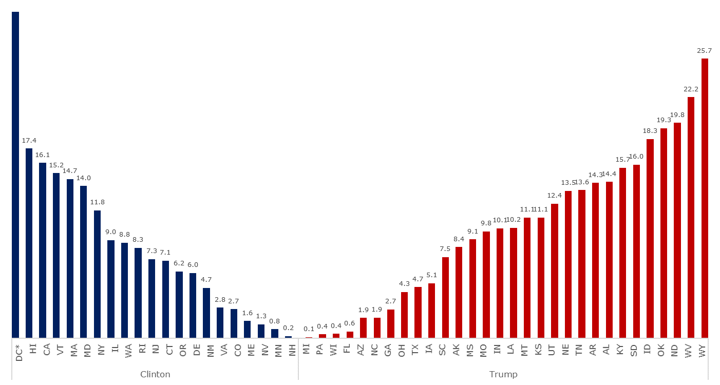
10 States with a Margin Less than 2% in 2016
State | Vote Margin | EC Votes
North Carolina | 173,315 | 15
Florida | 112,911 | 29
Arizona | 91,234 | 11
Minnesota | 44,593 | 10
Pennsylvania | 44,292 | 20
Nevada | 27,202 | 6
Wisconsin | 22,748 | 10
Maine | 22,142 | 4
Michigan | 10,704 | 16
New Hampshire | 2,736 | 4
47.9
Sources: National Journal Research, 2019.

Slide 16
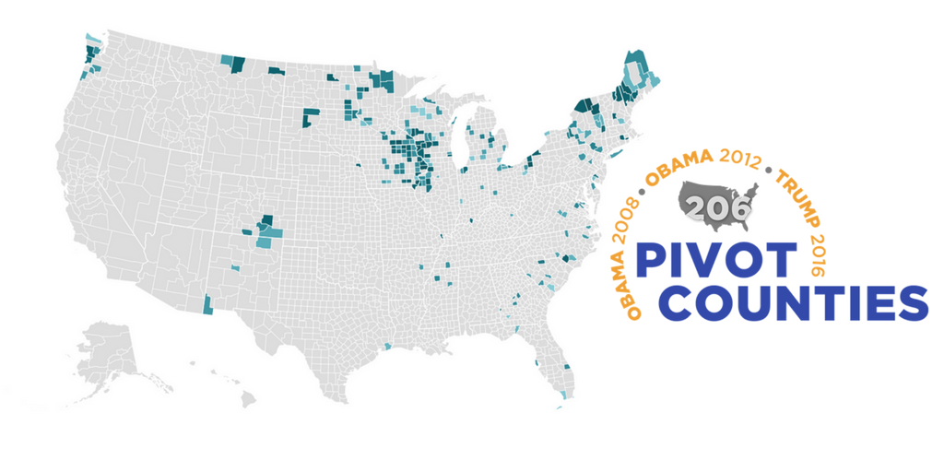

Slide 17
Recession’s Impact on Re-Election

Slide 18
Commit to Vote

